Slide 1
Exploratory Testing w/agentic AI
Llewellyn Falco

Slide 2
game rules have changed
cost(new) ≈ 0
What are the implications?

Slide 4


Slide 5
Do the basics work?
TDD

Slide 7
What else should I know about this software
Exploratory Testing

Slide 8
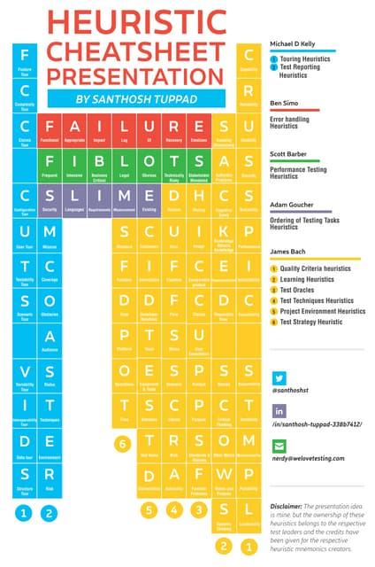

Slide 9




Elisabeth Hendrickson
James Bach
Michael Bolton
Ash Coleman

Slide 10




The Pieces
Interactions
Testing layer
Observations
Regression Tests
The Software
Shrink Layer
Plan
System Diagram

Slide 11

The Software - Testability
Testing interfaces
Original
Exposed pieces

Slide 12
Interactions
Custom MCP
MCP
CLI
Selenium

Slide 13
What is the app?
Webpage
Rest endpoint
Library
Phone App
Desktop App

Slide 14
Rest endpoint The Software - Testability
Side Effects
Real World impacts
Asynchronicity
Data Setup
State - Login
HTTPS ->
Testing Layer
Data <-
run.sh run_for_tests.sh

Slide 15
Rest endpoint – Testing Layer The Software - Testability
/test_login
/inital_data
/force_synchronous
/log_verbose /return_side_effects ?return_side_effects=true
Side Effects
Real World impacts
Asyncrousity
Data Setup
State - Login
Testing Layer
run_for_tests.sh

Slide 16
rest_testing_layer.process.md

Slide 17
The Software - Testability
Testing interfaces
Original
Exposed pieces

